Slide 1
WALLET SERVER
DESCRIPTION:- It is a console based wallet application which has the following functionalities.
Create Account
Deposit
Fund Transfer
Show Balance
Print Transaction

Slide 2
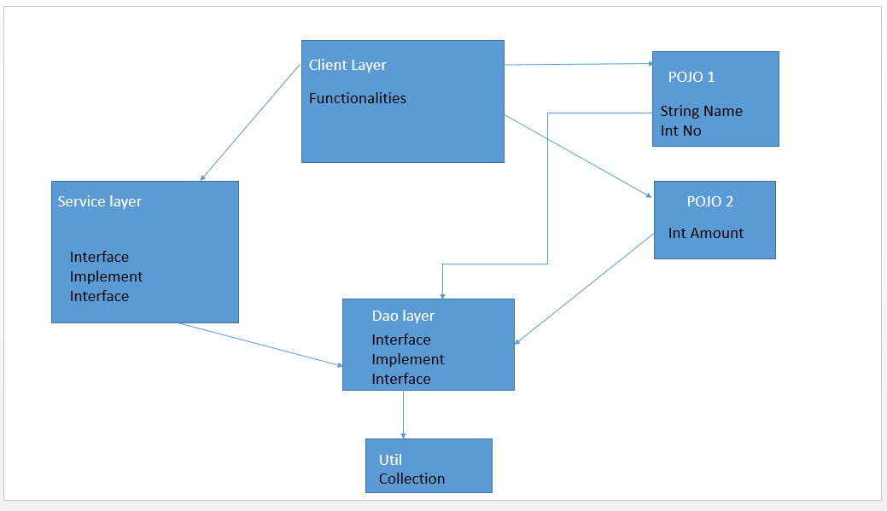
LAYERED ARCHITECTURE

Slide 3
Customer
private String customerName private int mobileNo private Account account
public void setMobileNo(int mobileNo) public int getMobileNo() public void setCustomerName(String CustomerName) public String getCustomerName() private setAccount (Account account) private account getAccount()
Account
private double amount private Transaction transaction
private setAmount(double account) Private getAmount(): double Private setTransaction(Transaction transaction) Private getTransaction(): transaction
Transaction
private int transaction_id; private int mobileNo private String transaction_type private double amount private date transaction_date
public void setTransaction_Id(int transaction_id) public int getTransaction_Id() public void setMobileNo(int mobileNo) public int getMobileNo() public void setTransaction_type(String transaction_type) public int getTransaction_type() public void setTransaction_date (date transaction_date) public int getTransaction_date()

Slide 4
DAO Interface
public customer create account public customer getAccount(String mobileNumber) public Boolean setAccount(String mobileNumber, double Amount) List<transaction>(String mobileNumber)
DAO_Impl

Slide 5
Service Interface
public customer create account public customer double show _Balance() Public customer Fund _Transfer() Public customer deposit_Amount() Public list<Transaction>getTransaction(String mobileNumber)
Service_impl

